Slide 1
VSWAPPER: A Memory Swapper for Virtualized Environments
Nadav Amit, Dan Tsafrir, Assaf Schuster

Slide 2
virtualization
Hardware virtualization enables the cloud ecosystem
Higher server utilization
Up to 50% less operating expenses
Up to 80% less power expenses
Memory is the biggest constraint for consolidation [IDC’09, Birke’12]
Memory overcommitment
Essential for server consolidation
App.
App.
App.
App.
VM
VM
Hypervisor

Slide 3
Uncooperative Swapping
RAM
P1
P2
guest view
disk
Guest Code
B
(1) Access
(2) Exit
RAM
P1
P3
P2
disk
host view
VM image
Hyper-visor
host swap area
P2
(3) Swap
Poor performance due to the semantic gap

Slide 4
Memory balloon
inflate
deflate
guest memory
guest memory
guest memory
balloon
swap out
virtual disk
swap in
Allows guest to make paging decisions, yet:
Ballooning takes time
Not a complete solution
Paravirtual
Virtualization vendor use host swapping as a backup

Slide 5
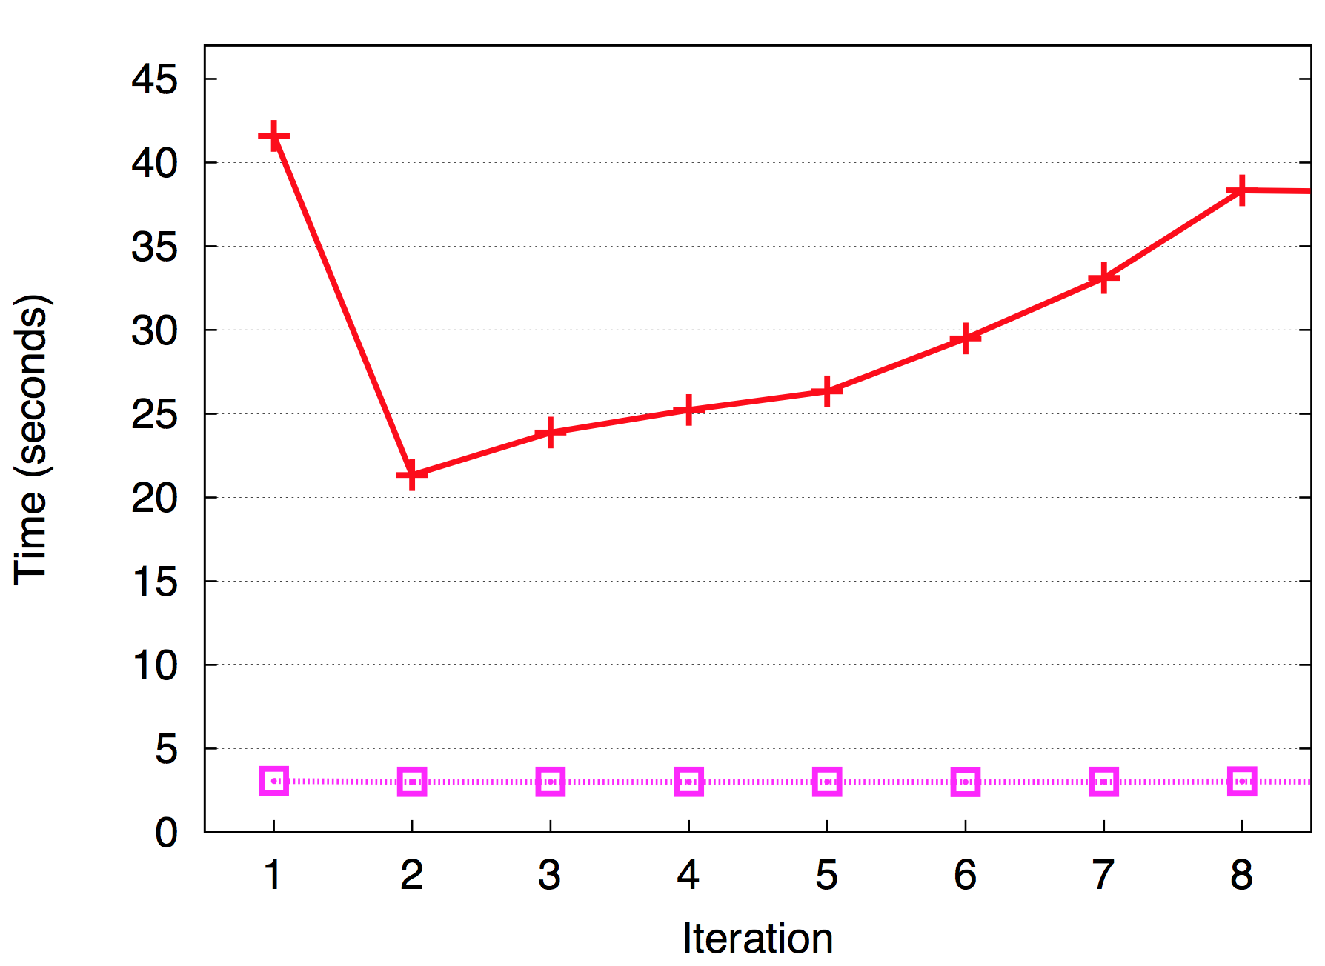
Demonstration: Sequential file read
512MB VM; 100MB cap; 200MB file; Read & re-read
Swapping
Files cached in guest memory; not in host
Disk read
Balloon

Slide 6
Agneda
Introduction
Problems
Solutions
Evaluation

Slide 7
Problem #1: Stale Swap Reads
Stale swap reads

Slide 8
Problem #1: Stale Swap Reads
RAM
P
(1) VM reads P2
P2
guest view
disk
P2
P2
RAM
(2) #PF → reading P
P
(3) over- write
it with P2
P2
disk
host view
VM image
P2
P2
P2
host swap area
P
P
P
Swap data is read just for disk blocks to overwrite it

Slide 9
Problem #2: False Swap Reads
RAM
(1) VM writes to P
P
(2) VM
over- writes
P
P
disk
host view
VM image
host swap area
P
Guest reallocates page frames:
Copy-on-write
Zero page before use
Slab pages

Slide 10
Problem #3: Silent Swap Writes
RAM
P
P
(1) vm reads page
(2) host swaps page
disk
host view
VM image
P
P
P
host swap area
P
Data read from the image is written back to the host swap

Slide 11
Problem #4: Decayed Swap Sequentiality

Slide 12
Problem #4: Decayed Swap Sequentiality
RAM
disk
host view
VM image
P1
P2
P3
host swap area
P2
P3
P1
VM image data gradually loses sequentiality on swap
Poor prefetch

Slide 13
Problem #5: False Anonymity
Userspace hypervisor code
guest: named host: anon
anon
RAM
P4
P1
P3
QEMU
disk
Swap out
host view
VM image
P1
P2
P3
host swap area
All guest memory is considered anonymous
OS prefers to evict named pages; hypervisor ignores

Slide 14
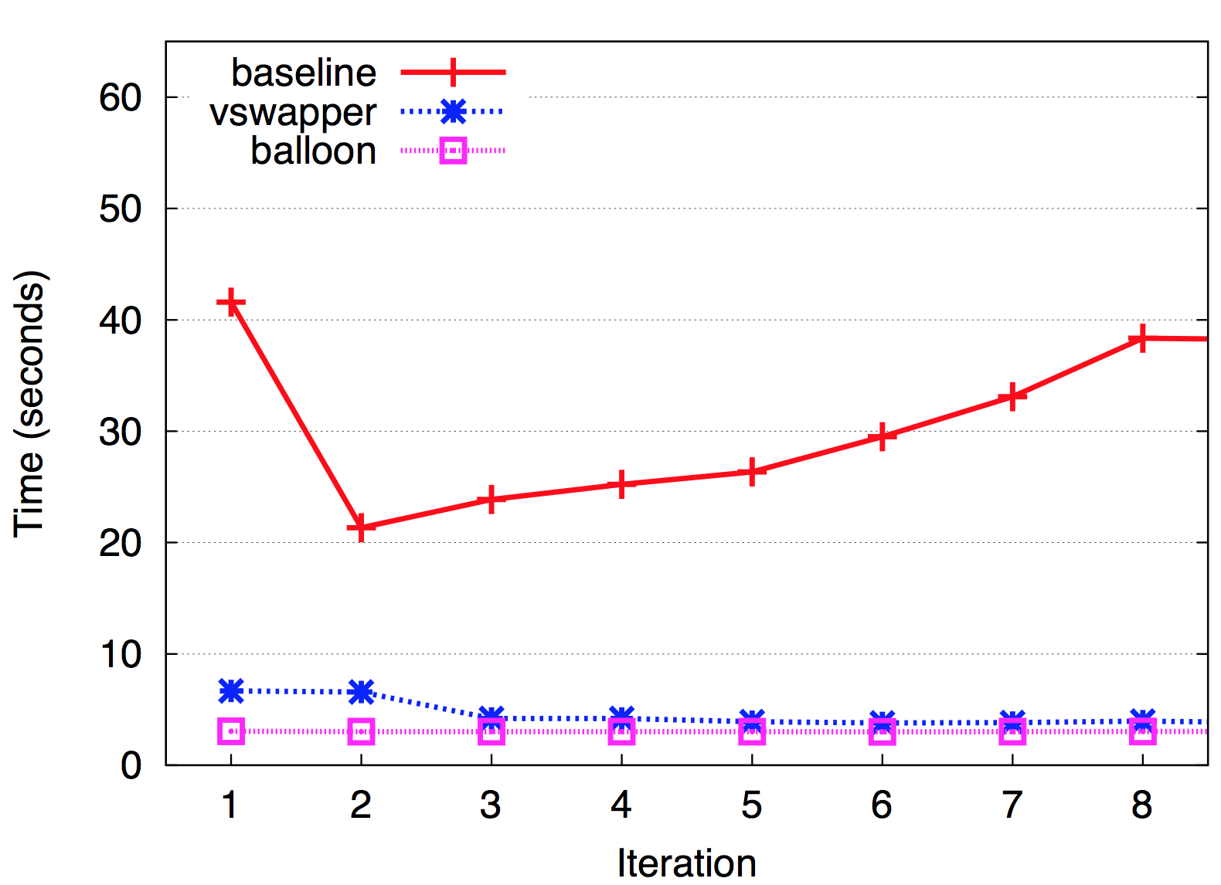
Demonstration: Sequential file read

Slide 15
Agneda
Introduction
Problems
Solutions
Evaluation

Slide 16
Solutions
Extension to existing swapping
Full-virtualization
No VM introspection
Based on general OS concepts
Can be used with ballooning
Two mechanisms
Swap mapper
False read preventer

Slide 17
Solution: Swap Mapper
(1) Read command
RAM
P
guest view
disk
B
(2) Exit
Associate guest memory page with disk block (P=B)
RAM
P
disk
(3) File read
host view
VM image
(3) mmap to file
B
(4) Remove mapping on write to P or B
Similar flow for writes

Slide 18
Solution: Swap Mapper
Solves:
Stale swap reads – map instead of read
Silent swap writes – no WB of clean pages
Decayed swap sequentiality – Data in its original place
False anonymity – pages from image are named
Subtleties:
Consistency
VM disk uses 4KB blocks
Prefetch only if present in guest physical memory
Remove from host cache if overwritten
Limitations
Overheads – CPU and memory
Cannot track migrated pages

Slide 19
Solution: False Read Preventer
mov [0x10], 5
Save VM writes to buffer
If page is rewritten, allocate one from free pool and remap
If not, fetch asynchronously and merge
Subtleties:
Selective emulation
Efficient emulation
Host reads
Virtual Machine
Exit
Entry
Hypervisor
Record
Fetch
[0x10]=5
Map
….5….
Writeback

Slide 20
Agneda
Introduction
Problems
Solutions
Evaluation

Slide 21
Evaluation
IBM R420 Server
KVM Hypervisor
Enterprise disk
Configurations
baseline: host-swapping, no host caching
mapper: swap mapper
vswapper: swap mapper and false read preventer
balloon: paravirtual balloon, host swapping enabled

Slide 22
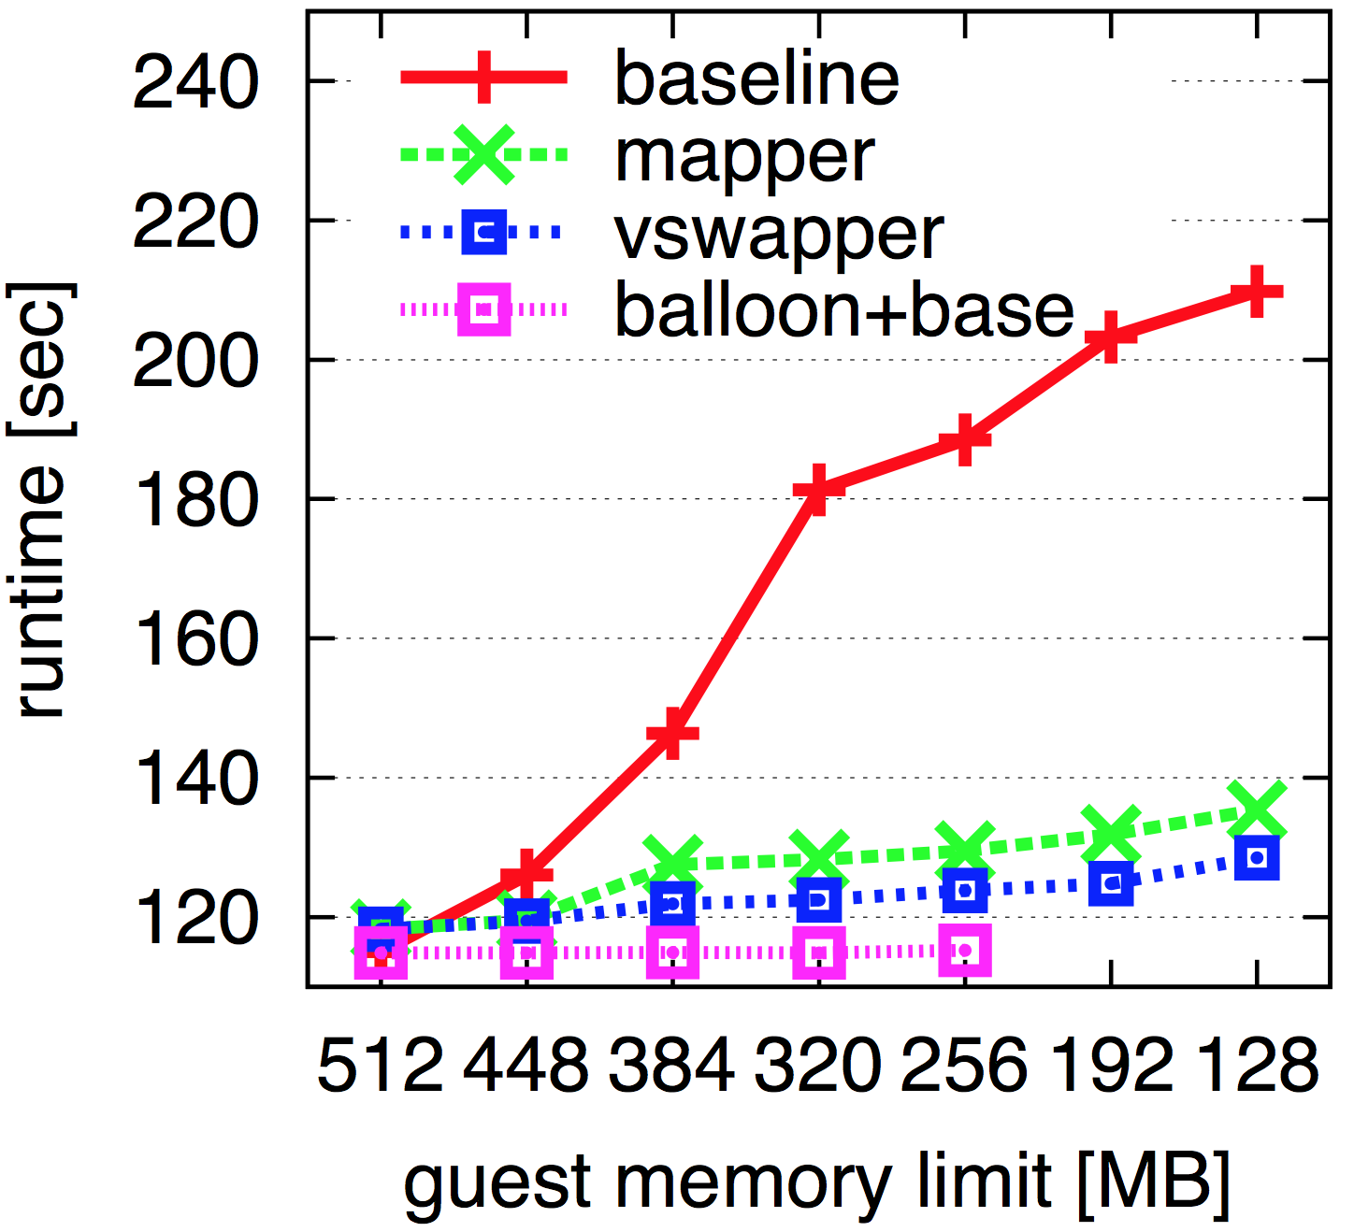
Pbzip2
VM: 512MB, 1VCPU
1.63x
speedup
OOM

Slide 23
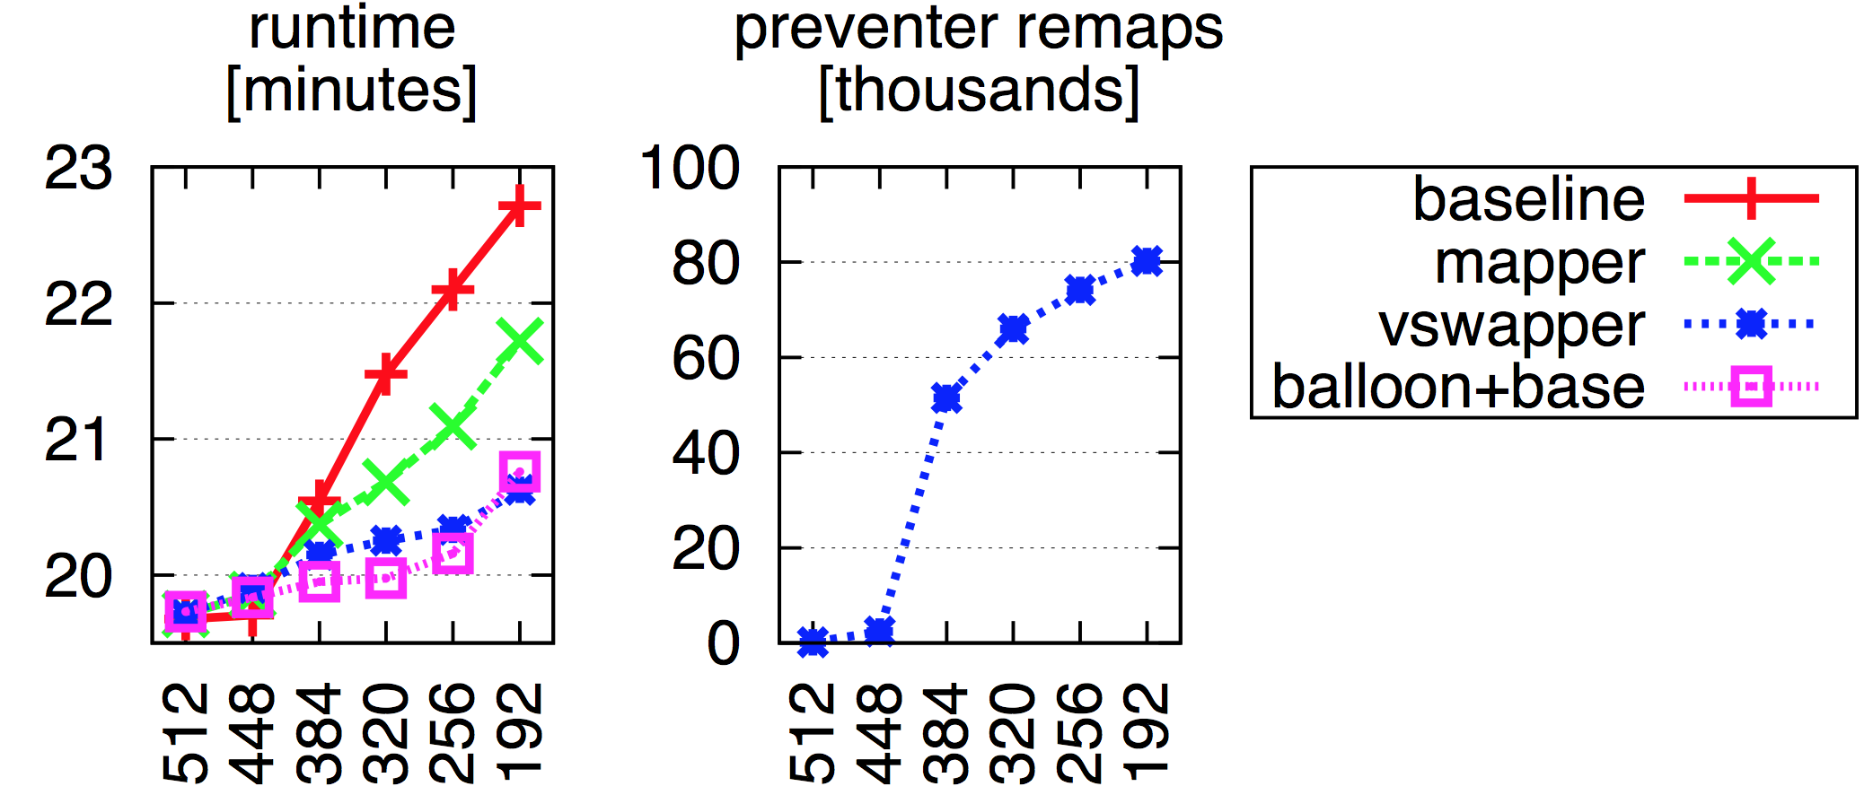
Kernbench
VM: 512MB, 1VCPU

Slide 24
Dynamic Workload: METIS MAP-REDUCE (WC)
VM: 2GB; Host: 8GB MoM manages balloon VMs started 10 sec. apart
2x
speedup (w/balloon)

Slide 25
Related Works
Monitoring the buffer-cache [Jones06]
Non-blocking writes [Useche12]
Memory overcommit mechanisms
Transcendent memory [Magenheimer’09]
Cooperative memory management [Schwidefsky’06]
Memory hot-plug [Schopp’06]

Slide 26
Conclusion
Host-swapping poor performance analysis and solution
Swap mapper
False read preventer
VSwapper integrates with balloon
Vswapper code is available nadav.amit.to/vswapper

Slide 27
Questions

